Slide 1
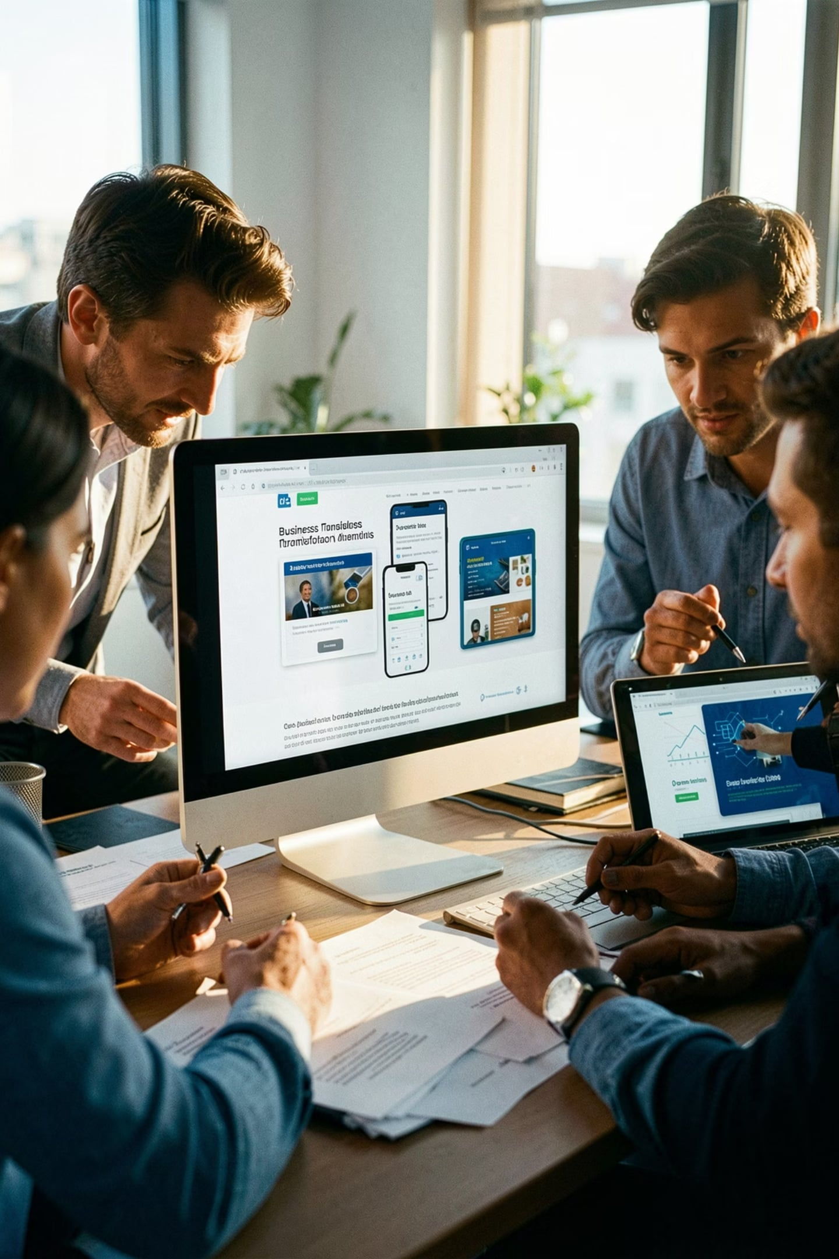

AGRAWAL BROTHERS SERVICES
Digital Solutions for a Traditional Business
Empowering Agrawal Brothers with modern technology — web, mobile, management, and social media.

Slide 2




A Three-Pillar Digital Strategy
Our comprehensive approach focuses on enhancing customer experience, streamlining internal operations, and boosting brand presence.
Customer Engagement
Operational Efficiency
Brand Visibility
Launching a dedicated mobile app to connect with customers, offer personalised services, and build loyalty.
Implementing a robust business management suite to automate processes, improve data management, and optimise workflows.
Developing a dynamic social media strategy to expand our reach, engage with the community, and amplify our brand story.

Slide 3

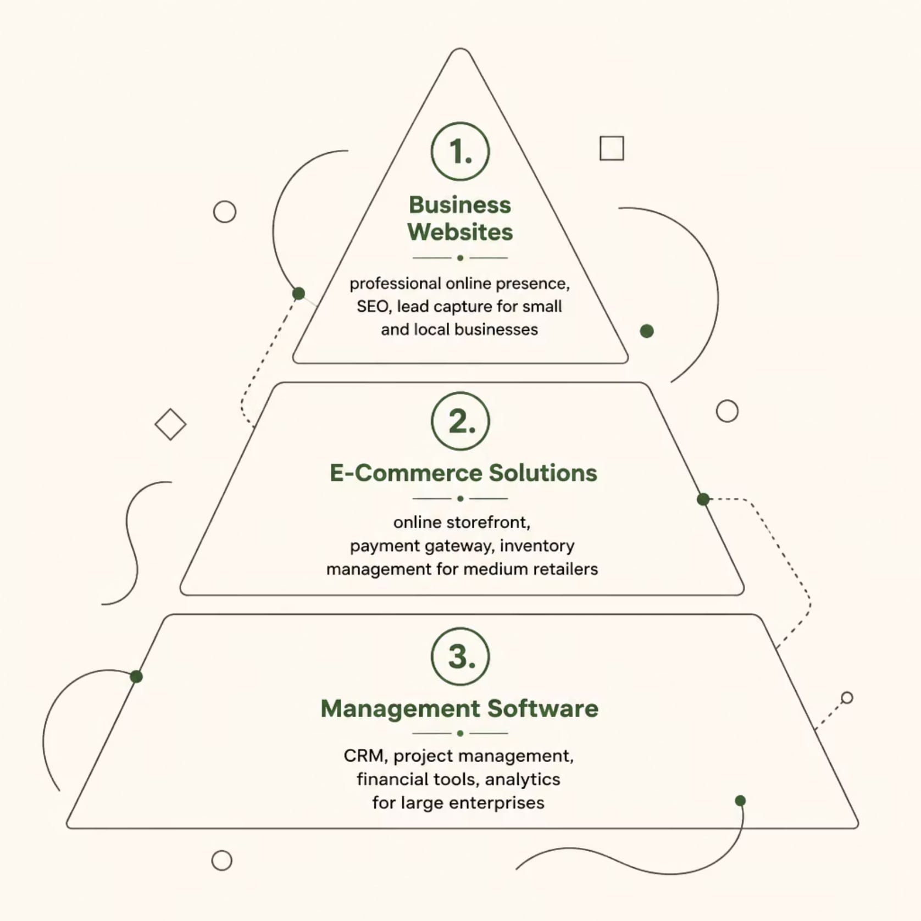
STRATEGY
A Three-Pillar Digital Strategy
Business Websites
Professional, mobile-friendly presence — your 24/7 digital brochure.
E-Commerce Solutions
Seamless online storefront with secure payments and inventory tools.
Management Software
CRM, finance, and analytics — one unified system.

Slide 4







MOBILE APP
The Agrawal Brothers App
Available on iOS & Android — your customers, always connected.
Product Catalog
Order Management
Browse inventory anytime
Place and track orders
Customer Chat
Store Locator
Direct support channel
Find us across cities
Loyalty Program
Promotions & Offers
Rewards and retention
Instant deals and updates

Slide 5

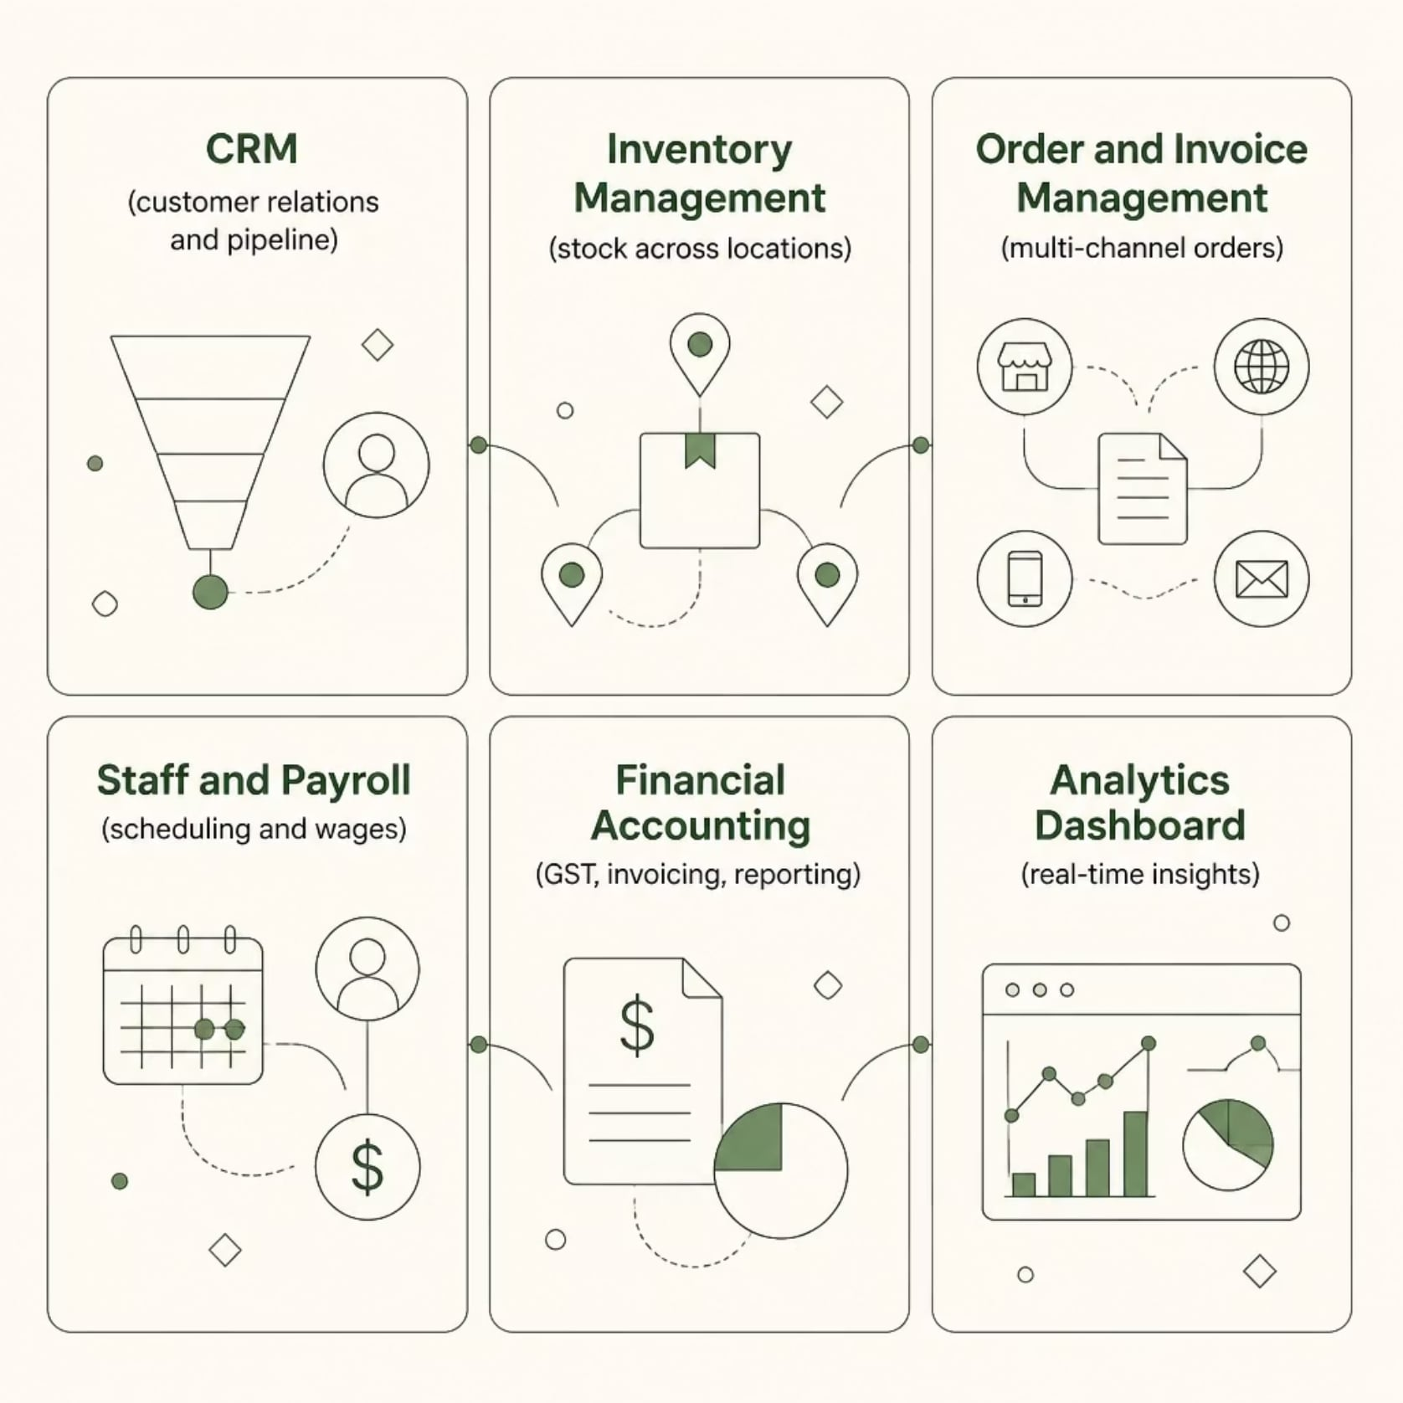

OPERATIONS
Business Management Suite
One platform to manage operations across Jaipur, Indore, Patna, and Rasra.
Real-Time Visibility
Multi-Location Control
Inventory and sales at a glance
Manage all branches centrally
Cost Reduction
Data-Driven Decisions
Automate manual processes
Insights that drive growth

Slide 6





Social Media Strategy
A targeted approach across every major platform.
Facebook
Instagram
Community building and customer interaction
Visual product and project showcase
LinkedIn
YouTube
B2B networking and credibility
Product videos and portfolio walkthroughs

Slide 7






Why Choose Us?
End-to-End Solutions
100+ Businesses
Modern Tech Stack
24/7 Support
Transparent Pricing
Let's Talk
📞 Phone
📧 Email
+91-XXXXXXXXXX
info@companyname.com
🌐 Website
📍 Address
www.companyname.com
Your Office Address

Slide 8

IMPACT
Measuring Our Success & ROI
Our digital transformation initiatives are designed to deliver measurable results, ensuring a strong return on investment across key business areas.
30%
40%
Increase in Customer Engagement
Reduction in Manual Process Time
25%
15%
Projected Revenue Growth (Year 1)
Operational Cost Savings

Slide 9

ROADMAP
Implementation Timeline & Roadmap
Our structured approach ensures timely delivery and seamless integration of all digital solutions.
Discovery & Planning
Testing & Refinement
In-depth analysis of current systems and strategic goal alignment.
Rigorous quality assurance and user feedback integration.
Design & Development
Launch & Support
Building robust and scalable web, mobile, and management platforms.
Go-live, user training, and continuous technical assistance.

Slide 10

Thank You!
We sincerely appreciate your time and attention today. We are confident that our proposed digital solutions will empower Agrawal Brothers to achieve remarkable growth and operational excellence. We look forward to partnering with you on this transformative journey.
Let's Connect
📞 Phone
📧 Email
+91-XXXXXXXXXX
info@companyname.com
🌐 Website
📍 Address
www.companyname.com
Your Office Address

